Slide 1
Principios de Arquitecturas Convolucionales: DenseNets

Slide 2

Lectura Recomendada
Dive into Deep Learning
Aston Zhang, Zachary C. Lipton, Mu Li, and Alexander J. Smola
https://d2l.ai/chapter_convolutional-modern/densenet.html

Slide 3
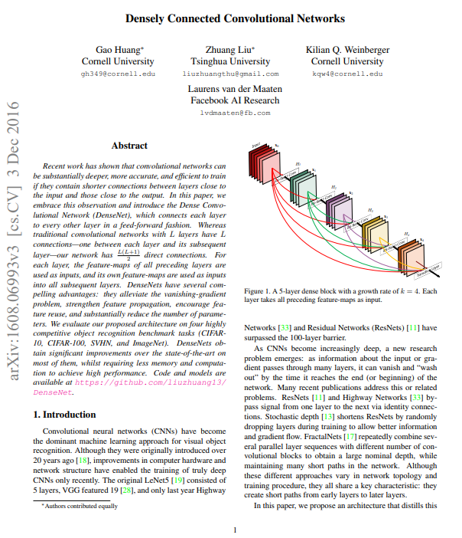
Lectura Recomendada
Densely Connected Convolutional Networks
Huang, G., Liu, Z., Van Der Maaten, L., & Weinberger, K. Q.
https://arxiv.org/pdf/1608.06993v3.pdf

Slide 4
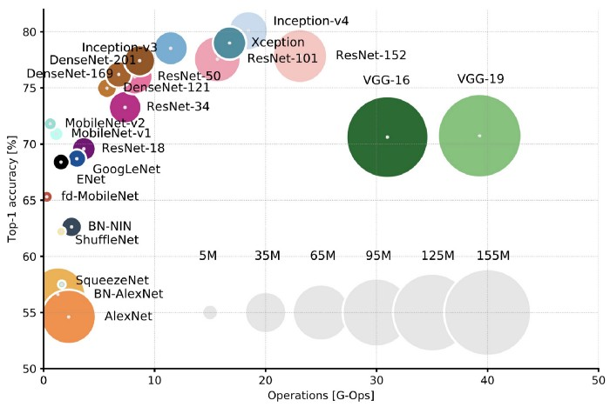
Redes y Cantidad de Operaciones
Canziani, A., Paszke, A., & Culurciello, E. (2016). An analysis of deep neural network models for practical applications. arXiv preprint arXiv:1605.07678.
https://culurciello.medium.com/analysis-of-deep-neural-networks-dcf398e71aae updated Figure 2: Top1 vs. operations, size ∝ parameters. Top-1 one-crop accuracy versus amount of operations required for a single forward pass. The size of the blobs is proportional to the number of network parameters; a legend is reported in the bottom right corner, spanning from 5×10^6 to 155×10^6 params. Both these figures share the same y-axis, and the grey dots highlight the centre of the blobs.

Slide 5
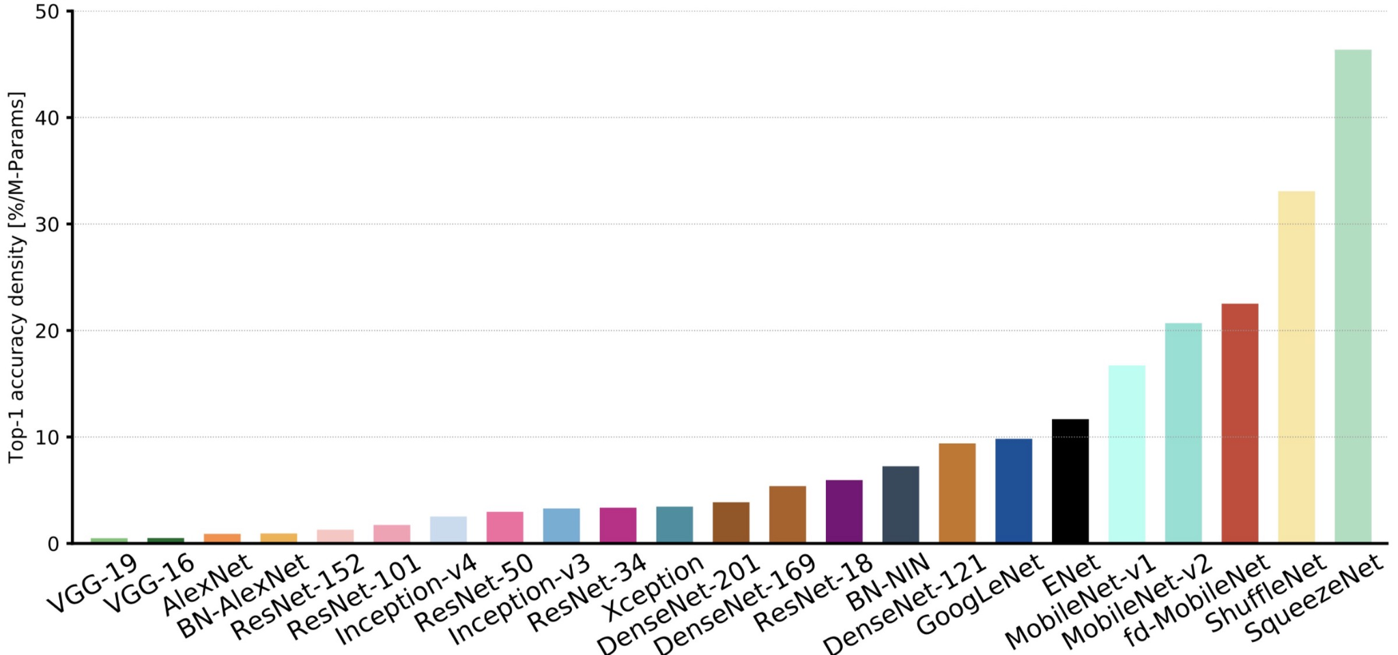
Redes y Cantidad de Operaciones
Canziani, A., Paszke, A., & Culurciello, E. (2016). An analysis of deep neural network models for practical applications. arXiv preprint arXiv:1605.07678.
https://culurciello.medium.com/analysis-of-deep-neural-networks-dcf398e71aae updated Figure 10: Accuracy per parameter vs. network. Information density (accuracy per parameters) is an efficiency metric that highlight that capacity of a specific architecture to better utilise its parametric space. Models like VGG and AlexNet are clearly oversized, and do not take fully advantage of their potential learning ability. On the far right, ResNet-18, BN-NIN, GoogLeNet and ENet (marked by grey arrows) do a better job at “squeezing” all their neurons to learn the given task, and are the winners of this section.

Slide 6
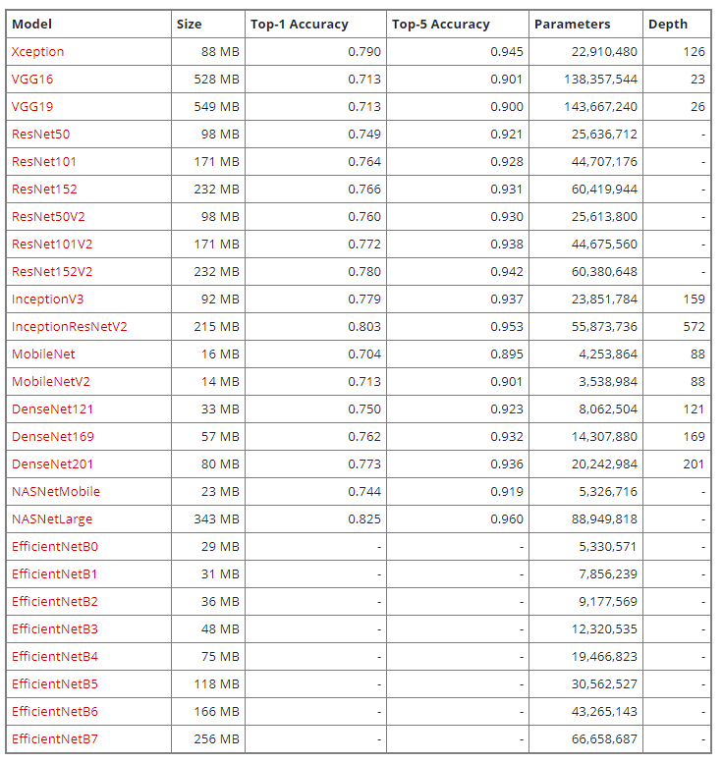
Redes y Cantidad de
Operaciones
Ver más: https://keras.io/api/applications/

Slide 7
Introducción
Trabajo anterior mostró que las redes convolucionales pueden ser sustancialmente más profundas, exactas y eficientes si contienen conexiones entre capas iniciales y finales

Slide 8
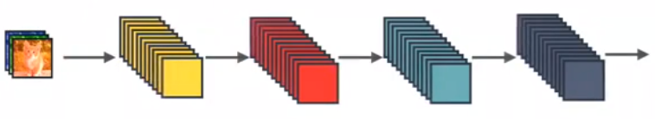
Introducción
En una red tradicional con L capas existen L conexiones, de una capa con la siguiente.
https://towardsdatascience.com/review-densenet-image-classification-b6631a8ef803

Slide 9
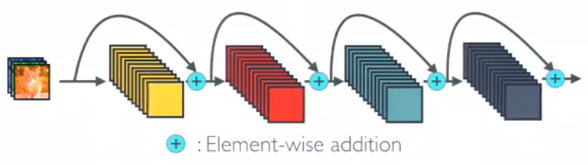
Introducción
En una ResNet tenemos skip connections aditivos
https://towardsdatascience.com/review-densenet-image-classification-b6631a8ef803

Slide 10
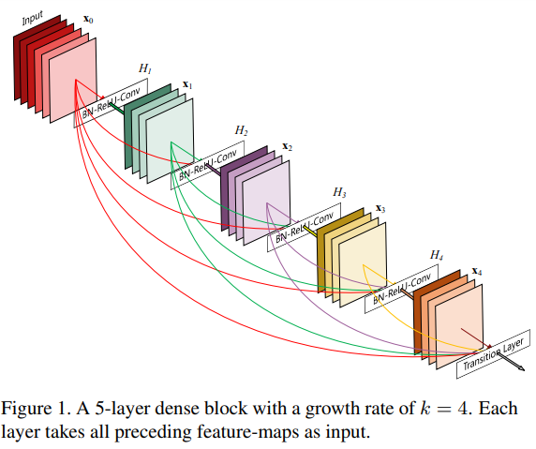
Introducción
En una DenseNet se tienen L(L+1)/2 conexiones, de una capa con todas sus subsecuentes
Huang, G., Liu, Z., Van Der Maaten, L., & Weinberger, K. Q. (2017). Densely connected convolutional networks. In Proceedings of the IEEE conference on computer vision and pattern recognition (pp. 4700-4708).

Slide 11
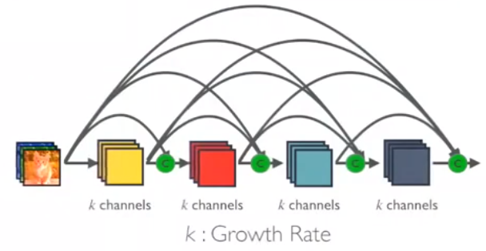
Introducción
En una DenseNet las conexiones son de concatenación
https://towardsdatascience.com/review-densenet-image-classification-b6631a8ef803

Slide 12
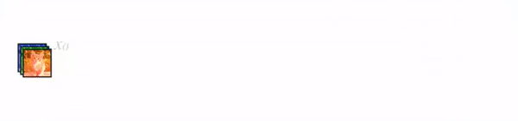
Introducción
En una DenseNet las conexiones son de concatenación
https://towardsdatascience.com/review-densenet-image-classification-b6631a8ef803

Slide 13
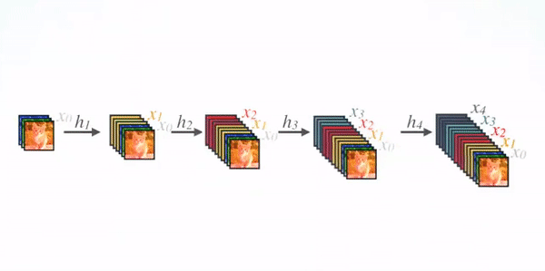
Arquitectura
https://towardsdatascience.com/review-densenet-image-classification-b6631a8ef803

Slide 14
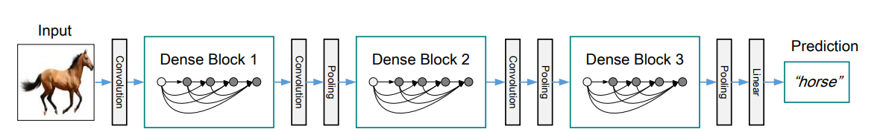
Arquitectura
Huang, G., Liu, Z., Van Der Maaten, L., & Weinberger, K. Q. (2017). Densely connected convolutional networks. In Proceedings of the IEEE conference on computer vision and pattern recognition (pp. 4700-4708).

Slide 15
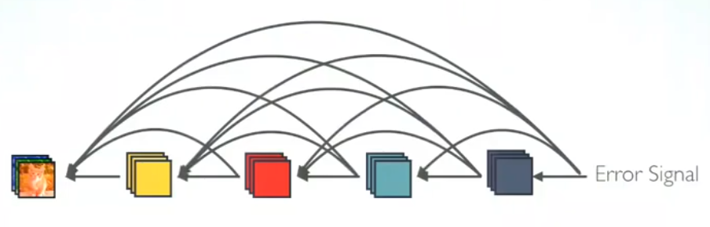
Gradient Flow
https://towardsdatascience.com/review-densenet-image-classification-b6631a8ef803

Slide 16
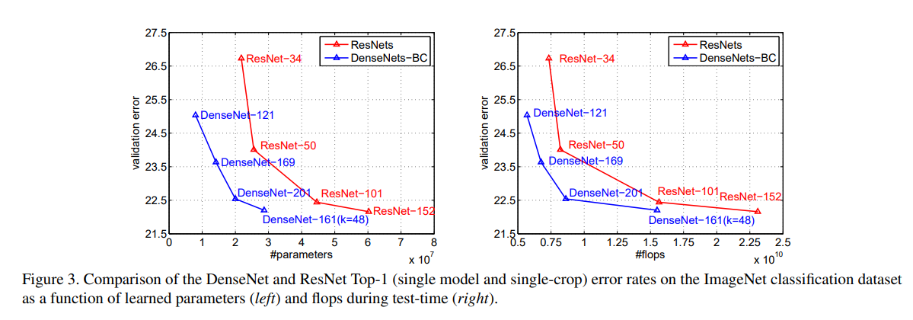
Cantidad de Parámetros: ResNet vs DenseNet
Huang, G., Liu, Z., Van Der Maaten, L., & Weinberger, K. Q. (2017). Densely connected convolutional networks. In Proceedings of the IEEE conference on computer vision and pattern recognition (pp. 4700-4708).

Slide 17
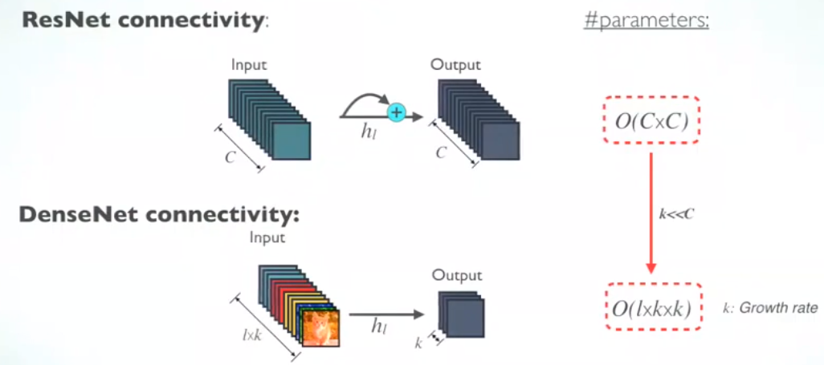
Cantidad de Parámetros: ResNet vs DenseNet
https://towardsdatascience.com/review-densenet-image-classification-b6631a8ef803
k<<C

Slide 18

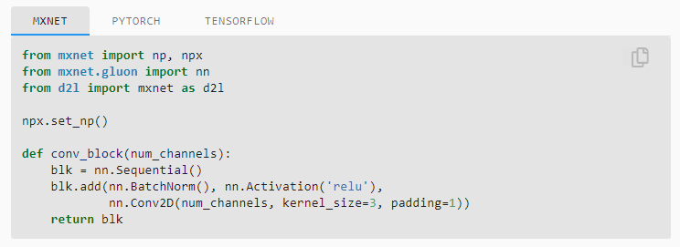
Bloque convolucional en DenseNet

Slide 19

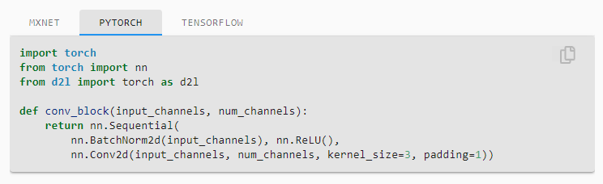
Bloque convolucional en DenseNet

Slide 20
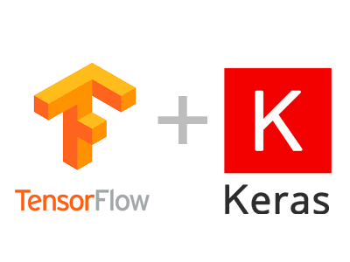
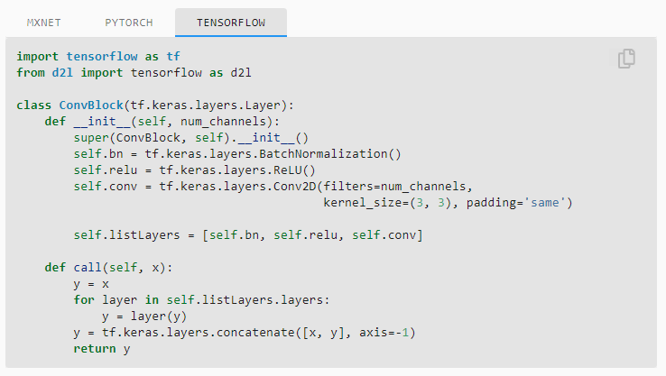
Bloque convolucional en DenseNet

Slide 21
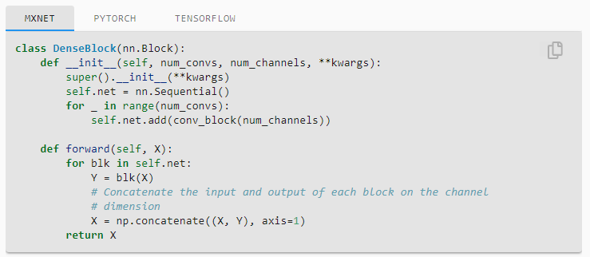
DenseBlock

Slide 22
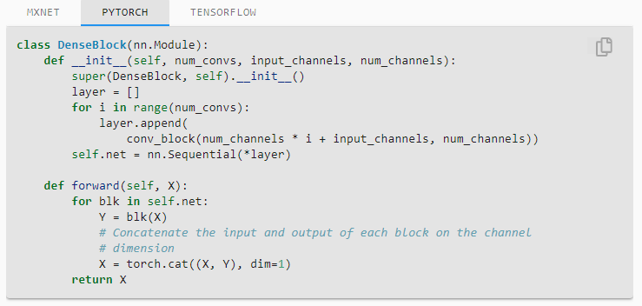
DenseBlock

Slide 23
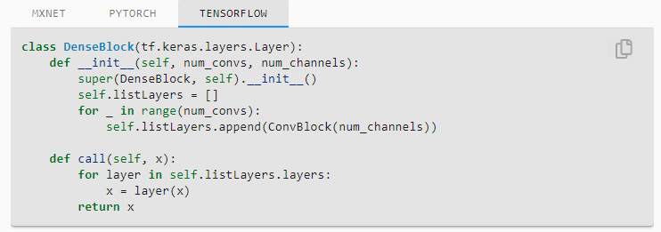
DenseBlock

Slide 24
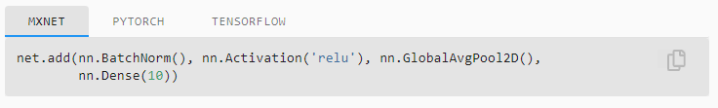
Salida en DenseNet

Slide 25
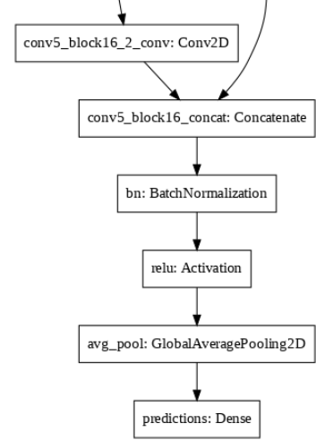
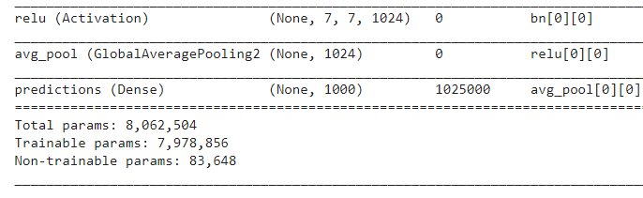
Salida en DenseNet

Slide 26
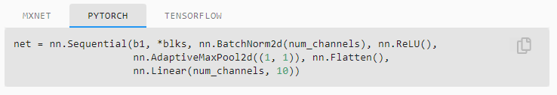
Salida en DenseNet

Slide 27
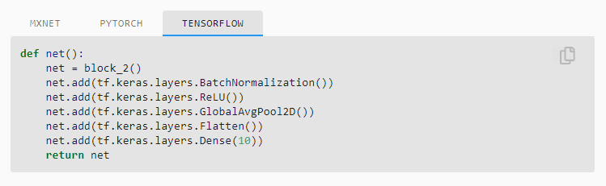
Salida en DenseNet

Slide 28
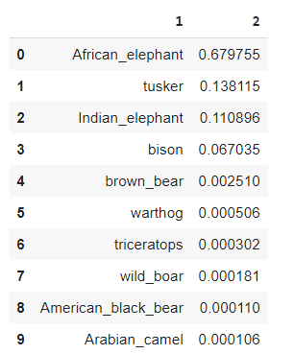
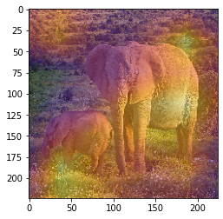
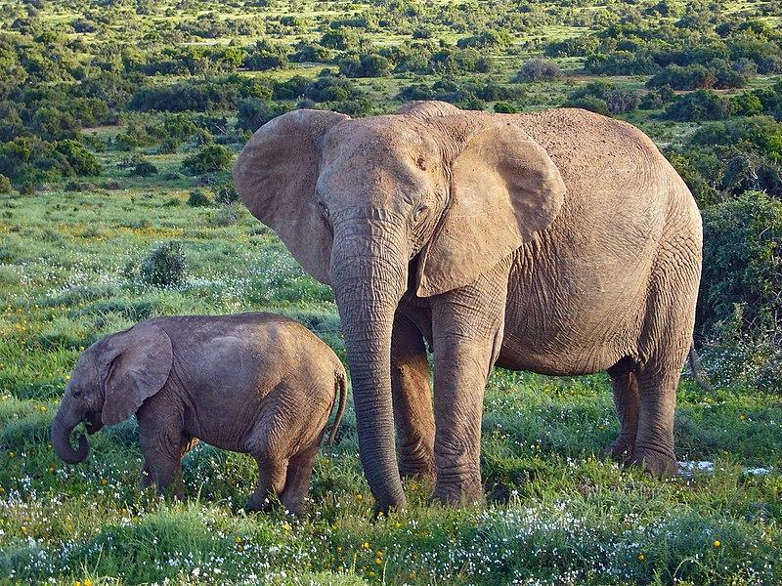
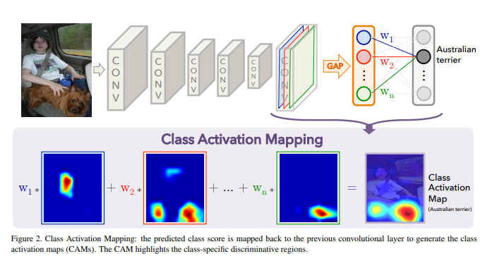
Salida en DenseNet 121

